Slide 1
Object Oriented testing

Slide 2
What is Object Oriented Programming?
Map the real world as “objects”
Objects have “state”
Objects have “behavior”
Original plan: Objects could be reused without modification or additional testing

Slide 3
What is Object Oriented Programming?
What is object oriented programming?
"Object-oriented programming is a method of programming based on a hierarchy of classes, and well-defined and cooperating objects. "
What is a class?
"A class is a structure that defines the data and the methods to work on that data. When you write programs in the Java language, all program data is wrapped in a class, whether it is a class you write or a class you use from the Java platform API libraries."

Slide 4
Class Example
Class: Person( … )
States: Age, height, weight, phone number, gender (these are instance variables)
Behaviors: getHeight( ), getWeight( ), computeBMI( ), computeLifeExpectancy( )
(these are methods)

Slide 5
OO Testing
OO Testing takes mostly in lower abstraction levels
Nature of OO systems influence both testing strategy and methods
Will re-use mean less need for testing? NO
In Object Oriented systems the view of testing is broadened to encompass Analysis and Design
“It can be argued that the review of OO analysis and design models is especially useful because the same semantic constructs (e.g., classes, attributes, operations, messages) appear at the analysis, design, and code level.”
Allows early circumvention of later problems

Slide 6
Differences between procedural testing and OO testing
Testing classes is a fundamentally different problem than testing functions. A function (or a procedure) has a clearly defined input-output behavior, while a class does not have an input-output behavior specification. We can test a method of a class using approaches for testing functions, but we cannot test the class using these
approaches.
According to Davis the dependencies occurring in conventional systems are:
Data dependencies between variables
Calling dependencies between modules
Functional dependencies between a module and the variable it computes
Definitional dependencies between a variable and its types.
But in Object-Oriented systems there are following additional dependencies:
  Class to class dependencies
  Class to method dependencies
  Class to message dependencies
  Class to variable dependencies
  Method to variable dependencies
  Method to message dependencies
  Method to method dependencies

Slide 7
Issues in OO Testing
Issues in Testing Classes:
Additional testing techniques are, therefore, required to test these dependencies. Another issue of interest is that it is not possible to test the class dynamically, only its instances i.e, objects can be tested. Similarly, the concept of inheritance opens various issues e.g., if changes are made to a parent class or superclass, in a larger system of a class it will be difficult to test subclasses individually and isolate the error to one class.
In object-oriented programs, control flow is characterized by message passing among objects, and the control flow switches from one object to another by inter-object communication. Consequently, there is no control flow within a class like functions. This lack of sequential control flow within a class requires different approaches for testing. Furthermore, in a function, arguments passed to the function with global data determine the path of execution within the procedure. But, in an object, the state associated with the object also influences the path of execution, and methods of a class can communicate among themselves through this state because this state is persistent across invocations of methods. Hence, for testing objects, the state of an object has to play an important role.

Slide 8
Object Oriented Testing methods:
Testing is a continuous activity during software development. In object-oriented systems, testing encompasses three levels, namely, unit testing, subsystem testing, and system testing.
Unit Testing:
In unit testing, the individual classes are tested. It is seen whether the class attributes are implemented as per design and whether the methods and the interfaces are error-free.
Unit testing is the responsibility of the application engineer who implements the structure.
Subsystem Testing:
This involves testing a particular module or a subsystem and is the responsibility of the subsystem lead. It involves testing the associations within the subsystem as well as the interaction of the subsystem with the outside.
Subsystem tests can be used as regression tests for each newly released version of the subsystem.

Slide 9
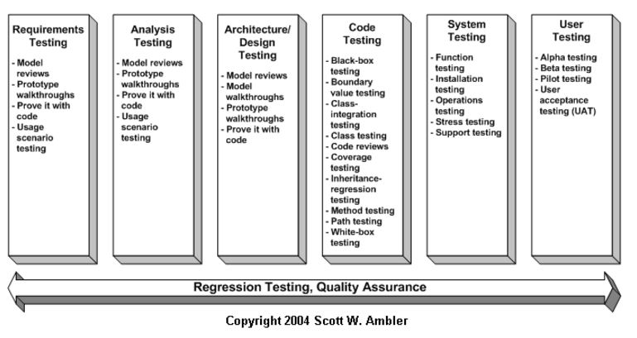
System Testing:
System testing involves testing the system as a whole and is the responsibility of the quality-assurance team. The team often uses system tests as regression tests when assembling new releases.

Slide 10
Object-Oriented Testing Techniques:
Grey Box Testing:
The different types of test cases that can be designed for testing object-oriented programs are called grey box test cases. Some of the important types of grey box testing are:
State model based testing: This encompasses state coverage, state transition coverage, and state transition path coverage.
Use case based testing: Each scenario in each use case is tested.
Class diagram based testing: Each class, derived class, associations, and aggregations are tested.
Sequence diagram based testing: The methods in the messages in the sequence diagrams are tested.
Techniques for Subsystem Testing:
The two main approaches of subsystem testing are:
Thread based testing: All classes that are needed to realize a single use case in a subsystem are integrated and tested.
Use based testing: The interfaces and services of the modules at each level of hierarchy are tested. Testing starts from the individual classes to the small modules comprising of classes, gradually to larger modules, and finally all the major subsystems.

Slide 11
Categories of System Testing:
  Alpha testing: This is carried out by the testing team within the organization that develops software.
  Beta testing: This is carried out by select group of co-operating customers.
  Acceptance testing: This is carried out by the customer before accepting the deliverables.
Black-box testing:
Testing that verifies the item being tested when given the appropriate input provides the expected results.
Boundary-value testing:
Testing of unusual or extreme situations that an item should be able to handle.
Class testing:
The act of ensuring that a class and its instances (objects) perform as defined.
Component testing:
The act of validating that a component works as defined.
Inheritance-regression testing:
The act of running the test cases of the super classes, both direct and indirect, on a given subclass.
Integration testing:
Testing to verify several portions of software work together.

Slide 12
Model review:
An inspection, ranging anywhere from a formal technical review to an informal walkthrough, by others who were not directly involved with the development of the model.
Path testing:
The act of ensuring that all logic paths within your code are exercised at least once.
Regression testing:
The acts of ensuring that previously tested behaviors still work as expected after changes have been made to an application.
Stress testing:
The act of ensuring that the system performs as expected under high volumes of transactions, users, load, and so on.
Technical review:
A quality assurance technique in which the design of your application is examined critically by a group of your peers. A review typically focuses on accuracy, quality, usability, and completeness. This process is often referred to as a walkthrough, an inspection, or a peer review.
User interface testing:
The testing of the user interface (UI) to ensure that it follows accepted UI standards and meets the requirements defined for it. Often referred to as graphical user interface (GUI) testing.
White-box testing:
Testing to verify that specific lines of code work as defined. Also referred to as clear-box testing.

Slide 13
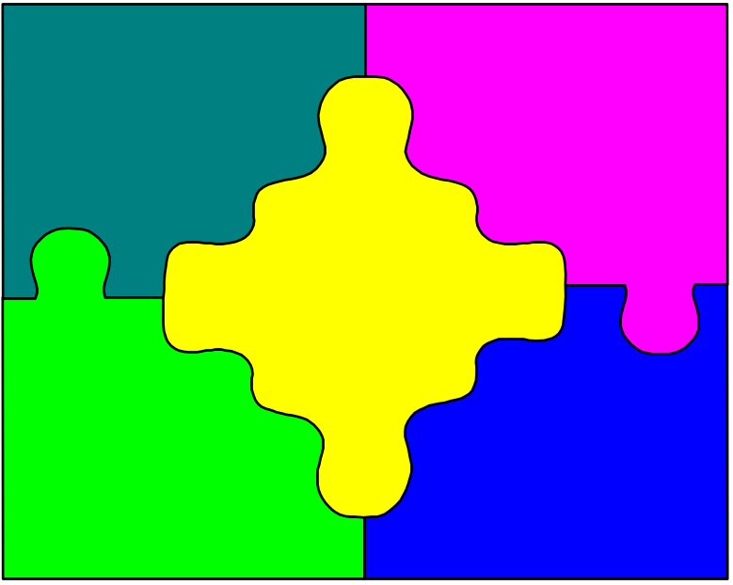
OBJECT ORIENTED TESTING
SYSTEM TESTING
INHERITANCE
INTEGRATION
TESTING
POLYMORPHISM
UNIT TESTING
ENCAPSULATION

Slide 14
Testing OO Code
class tests
integration
tests
system
tests
validation
tests

Slide 15
Effects on Testing
OO software has potentially more severe testing problems than traditional software
Objects don’t really exist until they’re instantiated
Input/process/output paradigm is gone
White Box testing can be more difficult
  Path and line coverage
  Code instrumentation

Slide 16
Traditional vs. Object-Oriented Testing
Data
Object
input
Data
Action
Action
Event
output
encapsulate
Device
Device
Thread
Event
Thread
Object-orientation repackages the basis concepts
(all relations are 0..n)

Slide 17
Object oriented testing
System
  Same as traditional
  Still based on reqrs spec
Unit
  Two common structures used
    Method*
    Class
  Same as traditional(drivers & stubs)
Notes:
>SYSTEM LEVEL TESTING - this level of testing is generally the same regardless of the development process. The end product still has to be verified against the original requirements specification using inputs to the system (black box) and analyzing the output.
>UNIT LEVEL TESTING - Unit testing of OO software is generally performed in the same manner as unit testing of non OO software. The only difference is what is the definition of a unit in OO software design and testing.
>There are currently two main stream approaches: a METHOD, or a CLASS.
>The main difference between the two approaches is the level of granularity.
>I believe the initial reaction of most software engineers is that a CLASS should be a unit since the structure is already clearly defined and from a high a level perspective it is easy to manage. However once examined a little closer it becomes apparent that this may not be the best choice. The next slides compares the two structures.

Slide 18
What causes the problems for testing?
Encapsulation/Composition
Inheritance
Polymorphism

Slide 19
Encapsulation: Definition
The binding together of data members and member functions in classes (structures)
Design decisions are hidden in the implementation
“The world” sees only the interfaces
Subclasses may inherit methods
Real burden of testing is at the Integration level, no matter how good the Unit Testing is

Slide 20
Encapsulation: Effects on testing (I)
Changing the implementation has ripple effects
Classes cannot be tested -- only instantiations of classes
If a superclass changes, the subclasses must be retested

Slide 21
Encapsulation: Effects on testing (II)
Methods inherited from a superclass must be retested in their new context
Two messages could be sent independently but concurrently, causing timing problems that can’t be tested very well
Classes may not get instantiated in the same order each time

Slide 22
Inheritance: Definition
New classes may be derived (inherited) from existing ones
Notation: A child class of a parent class; a base class and its derived class
Methods and variables may be inherited, even if not used
Strict vs non-strict inheritance (Inheritance is called strict if descendants do not delete or modify (override) any inherited features, non-strict otherwise. Basically, if A and B are classes and A is the strict father of B then object of type B has the same behavior as A with more features.)
Multiple and repeated inheritance (Repeated inheritance occurs whenever (as a result of multiple inheritance) two or more of the ancestors of a class D have a common parent A. D is then called a repeated descendant of A, and A a repeated ancestor of D)

Slide 23
Inheritance: Effects on testing
Strict: parent-class tests should work on the subclass
Non-strict: new tests are needed (methods may be renamed or not even present)
Multiple and repeated: Much worse! The
order of inheritance matters too
Cannot test the validity of the inheritance itself

Slide 24
INHERITANCE STRUCTURES
SINGLE
MULTIPLE
MULTIPLE LEVELS
BASE
BASE
BASE
BASE
SUBCLASS
SUBCLASS
SUBCLASS
SUBCLASS
Notes:
> The above slide gives an example of the some common inheritance structures
a. single;
b. multiple;
c. multi-level.
> Aggregation is not specifically shown here, however the testing issues are the same.

Slide 25
PERSON

EMPLOYEE
 
MGR GRUNT
If a method P takes Type Person as a parameter, then calling it with an Employee or a Grunt is allowed and must be tested

Slide 26
Example
Class C has methods M and N, and method M calls method N. D inherits from C, overriding M; E inherits from D, overriding N. M for sure must be tested in all 3 contexts.
C M( ), N( )

D overrides M( ), inherits N( )

E inherits M( ), overrides N( )

Slide 27
Polymorphism: Definition
“Many forms”
An object can be many types at once
From before: A class has state and behavior, plus all the states and behaviors of every class it inherits from
Methods and operations can be overridden

Slide 28
Polymorphism: Effects on testing
An inherited method that is overridden must be retested in the subclass
If the implementation is changed, new white box tests are needed
The reason for overriding almost certainly means new or different external behavior, so new black box tests are needed also

Slide 29
Levels of Object-Oriented Testing
Level
Item
Boundary
Unit
Method of an object?
Program graph
Class?
Integration
MM-Path
Message quiescence
Atomic System Function
Event quiescence
System
Thread
Source to sink ASF
(Atomic System Function (ASF)
Notice the cascading levels of interaction:
•
Unit testing covers statement interaction,
•
MM-Path testing covers method interaction,
•
ASF testing covers MM-Path interaction,
•
Thread testing covers object interaction, and all of this culminates in
thread interaction.

Slide 30
Two possible definitions of “unit”
A unit is the smallest software component that can be compiled and executed
A unit is a software component that would never be assigned to more than one developer
The main question for testing a class is whether the class itself, or its methods, are considered as units
Best choice: First bullet – a class is a unit

Slide 31
More on Units
If we consider methods as object-oriented units, then we must provide stub classes and a driver or “main program” class
If we consider classes as units, other problems arise:
  In a static view, inheritance is ignored
  Classes have to be instantiated to be tested
  Abstract classes cannot be tested
  If this class inherits, all its parents are needed

Slide 32
Class Testing

Slide 33
Class Testing
Main question: Are units methods or are units classes?
If methods are units, testing is like traditional software.
Classes as units makes more sense when there is little inheritance and a lot of complexity in the class

Slide 34
Classes as Units
Static view : Classes are simply code. This is fine for code reading, but inheritance is ignored, so “flattened” classes are needed
Compile-time view: Inheritance occurs, but no testing
Execution-time view: Instantiation occurs – this is where testing happens, of course
In any case, Abstract Classes cannot be tested.

Slide 35
Challenges of Class Testing
Encapsulation:
  Difficult to obtain a snapshot of a class without building extra methods which display the classes’ state
Inheritance:
  Each new context of use (subclass) requires re-testing because a method may be implemented differently (polymorphism).
  Other unaltered methods within the subclass may use the redefined method and need to be tested
White box tests:
  Basis path, condition, data flow and loop tests can all be applied to individual methods within a class but they don’t test interactions between methods

Slide 36
Saturn Windshield Wiper Controller
    For Intermittent setting, there are 3 “dial” sub-settings:
      1 : wiper wipes 4 times per minute
      2: wiper wipes 6 times per minute
      3: wiper wipes 12 times per minute
    For Low, the wiper wipes 30 times per minute
    For High, the wiper wipes 60 times per minutes
The windshield wiper on the Saturn automobiles is controlled by a lever with a dial. The lever has
four positions, OFF, INT (for intermittent), LOW, and HIGH, and the dial has three positions,
numbered simply 1, 2, and 3. The dial positions indicate three intermittent speeds, and the dial
position is relevant only when the lever is at the INT position. The decision table below shows the
windshield wiper speeds (in wipes per minute) for the lever and dial positions.
Lever
OFF
INT
INT
INT
LOW
HIGH
Dial
n/a
1
2
3
n/a
n/a
Wiper
0
4
6
12
30
60
Input Event
Description
Output Event
Description
ie1
lever from OFF to INT
oe1
0 w.p.m.
ie2
lever from INT to LOW
oe2
4 w.p.m.
ie3
lever from LOW to HIGH
oe3
6 w.p.m.
ie4
lever from HIGH to LOW
oe4
12 w.p.m.
ie5
lever from LOW to INT
oe5
30 w.p.m.
ie6
lever from INT to OFF
oe6
60 w.p.m.
ie7
dial from 1 to 2
ie8
dial from 2 to 3
ie9
dial from 3 to 2
ie10
dial from 2 to 1

Slide 37
Saturn Windshield Wiper Objects
Wiper
Speed
Lever Position
Dial Position
Compute Speed
Lever
Dial
position
position
Sense Up
Sense Left
Sense Down
Sense Right

Slide 38
Saturn Windshield Wiper Object FSMs
Lever
Dial
Input Event
Description
ie1
lever from OFF to INT
OFF
1
ie2
lever from INT to LOW
ie1
ie6
ie3
lever from LOW to HIGH
ie7
ie10
ie4
lever from HIGH to LOW
?
oe1
?
?
ie5
lever from LOW to INT
INT
2
ie6
lever from INT to OFF
ie7
dial from 1 to 2
ie2
ie5
ie8
ie9
ie8
dial from 2 to 3
oe5
?
?
?
ie9
dial from 3 to 2
LOW
3
ie10
dial from 2 to 1
ie3
ie4
Output Event
Description
oe6
oe5
oe1
0 w.p.m.
oe2
4 w.p.m.
HIGH
oe3
6 w.p.m.
oe4
12 w.p.m.
oe5
30 w.p.m.
oe6
60 w.p.m.
Note that several transition actions are indeterminate because of composition.

Slide 39
Resolving the Indeterminacy with Messages
Lever
Dial
Wiper
OFF
1
0 wpm
m1
ie1
ie6
ie7
m1
m1
m1
ie10
m6
m6
m6
m7
m10
m6
m7
m8
INT
2
4 wpm
6 wpm
12 wpm
m10
m9
ie2
ie5
ie8
ie9
m2
m2
m2
m2
m5
m8
m9
m5
m5
m5
LOW
3
30 wpm
ie3
ie4
m3
m3
m4
m4
HIGH
60 wpm
Messages m1 to m6 inform the Wiper object of the state of the Lever object.
Messages m7 to m10 inform the Wiper object of the state of the Dial object.

Slide 40
State Chart for the windshieldWiper class
power off
power on
0
instate(Int)
Off
instate(Off)
leverDown
leverUp
Int
Instate(1)
4
leverDown
Instate(2)
leverUp
Low
Instate(1)
leverDown
Instate(2)
6
leverUp
High
Instate(3)
Instate(2)
Instate(3)
12
1
dialDown
instate(Low)
instate(Int)
dialUp
2
30
dialDown
instate(High)
instate(Low)
dialUp
3
60

Slide 41
State Chart Metrics
State Charts like the preceding lend themselves to test metrics:
  Test every event
  Test every state in a component
  Test every transition in a component
  Test all pairs of interacting states between components
  System Testing: Use scenarios/use cases

Slide 42
Object-oriented Integration Testing

Slide 43

Integration Testing
OO does not have a hierarchical control structure so conventional top-down and bottom-up integration tests have little meaning
Integration applied three different incremental strategies
  Thread-based testing: integrates classes required to respond to one input or event
  Use-based testing: integrates classes required by one use case
  Cluster testing: integrates classes required to demonstrate one collaboration

Slide 44
OO Integration Testing
As noted before, Integration Testing is the major issue of object-oriented testing
If a method is a unit, then two levels of integration are needed:
  Integrating the method/operation into the class
  Integrating the class with other classes
If a class is a unit, any flattened classes must be restored and any test code removed

Slide 45
F
OBJECT CLASS A
METHOD 1
METHOD
METHOD 2
E
METHOD
B
C
D
METHOD
METHOD
METHOD
Notes:
>UNIT CLASS - The above diagram illustrates an example of an Object Class “A” which has two methods. This Object Class has a dependency association with all other Classes as shown. If a change was made to the unit “Object Class A” (METHOD 2), in theory all test cases involving the unit should be rerun, at all levels.
>Advantage: The dependency diagrams required for testing are less complex and association is easier to manage.
>Disadvantage: This level of granularity could result in a lot of unnecessary regression testing at the integration and system levels.

Slide 46
F
OBJECT CLASS A
METHOD 1
METHOD
METHOD 2
E
METHOD
B
D
C
METHOD
METHOD
METHOD
Notes:
>UNIT METHOD - using the same scenario with both method 1 and method 2 of Class A as units and a change is made to method 2, only test cases involving method 2 need to be rerun. In the above example this would only involve one method from Object Class B.
>Advantages: This approach could result in significant savings because of the reduction in the amount of regression testing required.
>Disadvantage: However, in a large systems the dependency associations between methods can quickly become complex and unmanageable.
>TOOLS . In order scale up to larger systems, whether a method or a class is used as a unit, there is definite requirement for some form of automated tool that can quickly tell a tester the effect of making changes( what test cases should be rerun (regression testing)).

Slide 47
A
OUTPUT PORT EVENT
Class 1
Class 3
A
meth1
meth2
1
meth1
meth2
meth3
B
B
OUTPUT PORT EVENT
Class 2
2
meth1
meth3
3
MM-Path
Message
meth2
Notes:
>The overall slide is an example of a CLUSTER of Object Classes that are required to perform a common operation.
> It also serves as an example of a DIRECTED GRAPH which shows the method dependencies among the classes, and the direction of message flow.

Slide 48
Integration Testing of Object-Oriented Software
•
Definition in UML
•
Two kinds of o-o software:
- data-driven
- event-driven
•
How are these described (for a tester)?
•
What is an o-o unit:
- a class?
- a method?
•
What is the basis for integration testing? (next slide)

Slide 49
UML Usage
Basis for Integration Testing: collaboration and sequence diagrams
Collaboration diagrams show the message traffic among classes
Collaboration diagrams support both pairwise integration and neighborhood integration

Slide 50
First Example (data-driven)
The o-oCalendar program is an object-oriented
implementation of the NextDate function.
(NextDate(Mar., 5, 2002)) = Mar., 6, 2002.
When this is implemented in procedural code, it is
approximately 50 lines long.
A "pure" (i.e., good practice) object-oriented
implementation contains one abstract class and
five classes. The next few slides show lead to the
Collaboration Diagram.

Slide 51
Classes
testIt
CalendarUnit
'abstract class
Date
currentPos As Integer
Day d
Month m
CalendarUnit( pCurrentPos)
Year y
setCurrentPos( pCurrentPos)
increment()
'boolean
Date( pDay, pMonth,, pYear)
increment()
printDate()
Month
private Year y
private sizeIndex =
<31, 28, 31, 30, 31, 30, 31, 31,
Day
Year
30, 31, 30, 31>
Month m
Year(int pYear)
Month(pcur, Year pYear)
setCurrentPos(pCurrentPos)
Day( pDay, Month pMonth)
setCurrentPos( pCurrentPos)
setMonth(pcur, Year pYear)
setCurrentPos( pCurrentPos)
getYear()
getMonth()
setDay( pDay, Month pMonth)
increment()
getMonthSize()
getDay()
isleap()
'boolean
increment()
increment()

Slide 52
Inheritance and Aggregation
CalendarUnit
Day
Month
Year
Date
Day
Month
Year

Slide 53
Program Graphs of testIt and Date Classes
testIt
Date.constructor
Date.increment
Date.printDate
1
4
8
19
2
5
9
20
3
6
10
7
11
12
15
13
16
14
17
18

Slide 54
Program Graphs of Day Class
Day.constructor
Day.setCurrentPos
Day.setDay
Day.getDay
Day.increment
21
a
23
26
28
22
b
24
27
29
23
25
30
31
32
33

Slide 55
Program Graphs for the Month Class
Month.constructor
Month.setCurrentPos
Month.setMonth
39
a
36
40
b
37
39
38
Month.getMonth
Month.increment
Month.getMonthSize
39
47
41
40
48
42
43
44
49
45
50
51
52
46

Slide 56
Program Graphs of Year Methods
Year.constructor
Year.setCurrentPos
Year.getYear
Year.increment
Year.isLeap
53
a
55
57
60
54
b
56
58
61
62
63
59
64

Slide 57
Collaboration Diagram
1: create
2: increment
3: getYear
Year
1: create
1:isLeap
1: create
2: increment
2: increment
3: setMonth
3: printDate
4: getMonth
testIt
Date
Month
1: create
1:getMonthSize
2: increment
3: setDay
4: getDay
Day

Slide 58
All Message Flows
Day
Day()
m15
testit
m6
setCurrentPos()
m16
Main
m7
increment()
setDay
getDay
m11
m13
m17
Date
Month
m5
Month()
m18
m1
Date()
setCurrentPos()
increment()
m8
increment()
m19
m2
printDate
m10
setMonth
m3
getMonth
getMonthSize
m4
Year
m20
m9
Year()
setCurrentPos()
m21
increment()
m14
getYear
isLeap

Slide 59
Message Sequence Diagram (for an easy test case)
testIt
Date:testdate
Day:d
Month:m
Year:y
1: printDate()
2:getMonth()
3:getDay()
4:getYear()
time

Slide 60
Message Flow for Easy Case
Day
Day()
m15
testit
m6
setCurrentPos()
m16
Main
increment()
setDay
getDay
Date
Month
m5
Month()
m18
m1
Date()
setCurrentPos()
increment()
increment()
m19
printDate
setMonth
getMonth
getMonthSize
m4
Year
Year()
m21
setCurrentPos()
increment()
getYear
isLeap

Slide 61
CONSTRUCT DEFINITIONS
MM-path (method message - path) [message quiescence]
  Sequence of executions linked by messages.
  Starts with method and ends with a method that doesn’t produce a message
Notes:
>This slide describes the testing concepts of message quiescence and the new construct a Method Message path (MM-path) which represents message quiescence.
.MM-path: represents a sequence of method executions linked by messages. It starts with a method and ends when it reaches a method which does not issue any messages of its own. (message quiescence).

Slide 62
CONSTRUCT DEFINITIONS
ASF (atomic system function) [event quiescence]
  Represents an input event
  Followed by a set of mm-paths
  Terminated by an ouput event
Notes:
> ASF: represents an input event, followed by a set of MM-paths, and terminated by an output event (event quiescence). In other words an event triggers a set of MM-paths that ends with some output event.

Slide 63
INPUT PORT EVENT
A
OUTPUT PORT EVENT
Class 1
Class 3
A
meth1
meth2
1
meth1
meth2
meth3
B
B
ASF INPUT PORT
EVENT
ASF OUTPUT PORT
EVENT
Class 2
2
meth1
meth3
3
MM-Path
Message
meth2
Notes:
>This slide illustrates the testing concepts of message and event quiescence and the two new constructs a Method Message path (MM-path) and an Atomic System Function (ASF). The circles represent various objects that contain methods represented by the rectangles.
MM-paths. The diagram shows 3 MM-paths (labeled 1,2,3). Since MM-paths are composed of linked method message pairs in an object network, they interleave and branch off from other MM-paths.
ASF. The diagram shows two ASFs, input events (called input port event) (labeled A,B) and their corresponding output port events .
>The more complicated example using MM-path 2 and 3 would proceed as follows:
step 1. integration test MM-path 3;
step 2. then integrate it with MM-path 2 and test using the input port events actual or simulated.

Slide 64
Object-oriented System Testing

Slide 65
System Testing
True system testing does not require knowing whether the implementation is procedural or object-oriented
The goal is to identify threads
Procedural implementation: We used behavioral models
OO implementation: UML use cases – high-level, essential, and expanded-essential

Slide 66
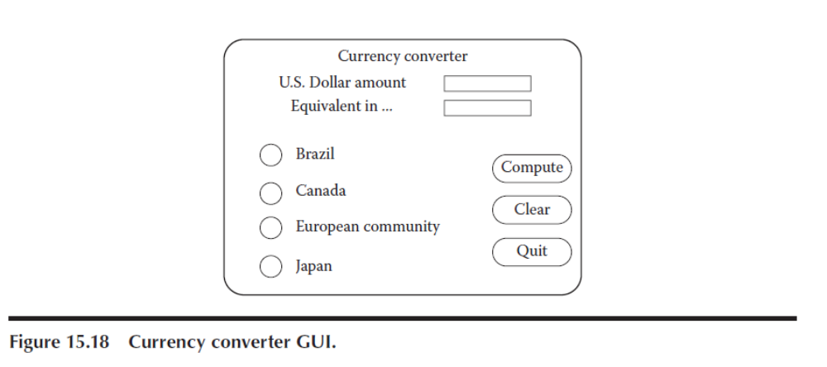
Currency Converter UML Description
The currency converter application converts U.S. dollars to any of four currencies: Brazilian reals, Canadian dollars, European Community euros, and Japanese yen. The user can revise inputs and perform repeated currency conversion.

Slide 67
Conclusion
Class/Objects are MUCH more complicated than procedures
  Need to consider encapsulation, inheritance and polymorphism
  OO Design proceeds by composition instead of decomposition
Encapsulation together with Inheritance, which intuitively ought to bring a reduction in testing problems, compounds them instead.
Complexity is moved from methods to messaging among objects
How can code be reused if it is not possible to demonstrate its quality?
Above all, if at all possible, avoid multiple and repeated inheritance

Slide 68
Flattening the Class

Slide 69
Inheritance issue
Inheritance is an important part of the object oriented paradigm
Unit testing a class with a super class can be impossible to do without the super classes methods/variables

Slide 70
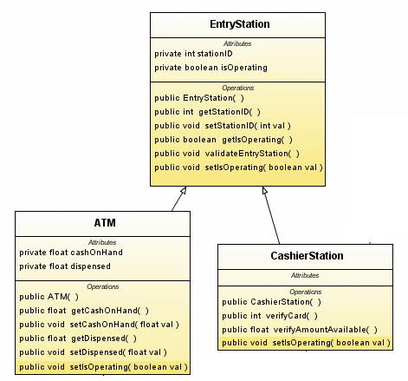
Example1

Slide 71
Issues in Object-Oriented Testing
Account
AccountNumber
balance
Getbalance()
setBalance()
savingsAccount
CheckingAccount
AccountNumber
Balance
CheckProcessingCharge
checkNumber
AccountNumber
Balance
interestRate
checkingAccount
savingsAccount
Getbalance()
setBalance()
PostInterest
checkProcessingCharge
checkNumber
interestRate
Getbalance()
setBalance()
PostCharges()
postInterest
Flattened classes: we test
the same function several times
Inheriting classes: we cannot test
with unit testing (balance cannot
be accessed)

Slide 72
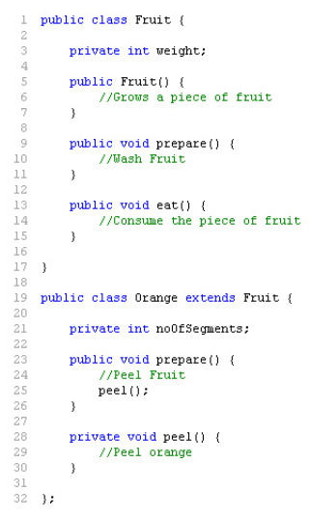
Problem

Slide 73
One Solution - Flattening
Merge the super class, and the class under test so all methods/variables are available
  Solves initial unit test problems
Problems:
  The class won’t be flattened in the final product so potential issues may still arise
  Complicated when dealing with multiple inheritance

Slide 74
Flattening sample solution
ClassA
Method1
Method2
Flattened Class
ClassB
Method1
Method2
Method3
ClassB
Method1
Method3

Slide 75
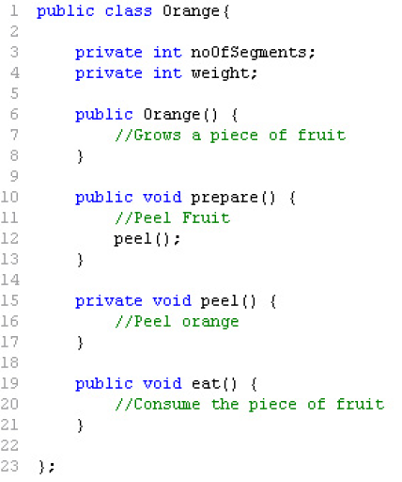
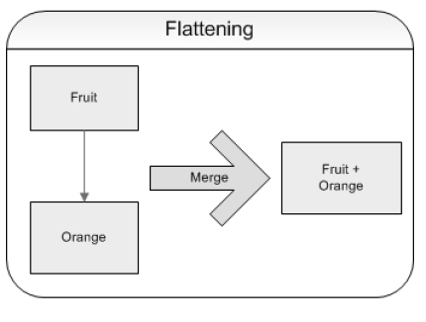
Orange problem

Slide 76
Account
Accounts example
+ open()
+ balance()
- privMethod()
Flattened scope
SavingsAccount
+ balance()
+ setInterestRate()
Class scope of SavingsAccount

Slide 77
Polymorphism Issues
Repeatedly testing same methods
Time can then be wasted if not addressed
Potentially can be avoided,and actually save time

Slide 78
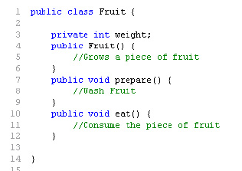
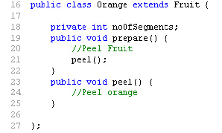
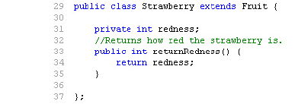
Polymorphism example

Slide 79
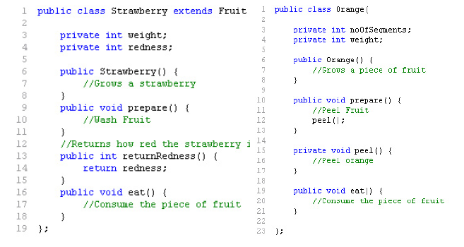
Polymorphism Issues - Example Code

Slide 80
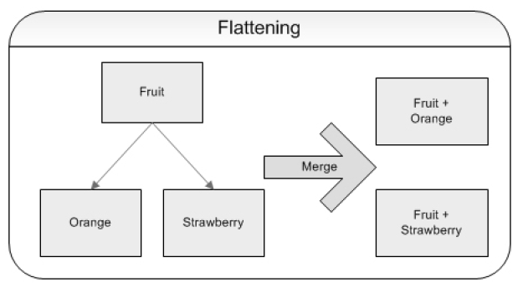
Solution

Slide 81


